Slide 1
RobotC Introductory Seminar: Advanced Topics
Robert Atkinson
Mentor, FTC Team 417
bob@theatkinsons.org
27 August 2011

Slide 2
Overview
Joysticks
Taking human control of your bot
Motors
Making your robot go
Telemetry
Getting actual data off the NXT so you can understand why on earth it didn’t do what you thought you told it to do
Tasks
Doing several things at once

Slide 3
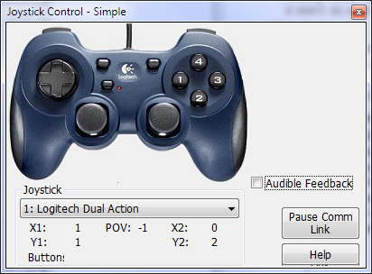
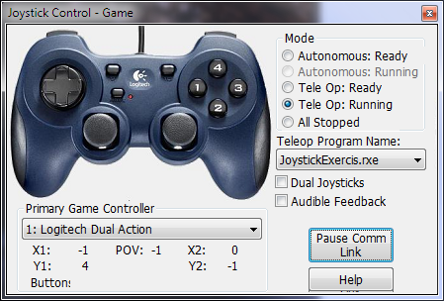
Joystick Controllers
TeleOp mode in First Tech Challege is played with one or two 10-button joystick controllers
Robot/Debugger Windows/Joystick Control - Game

Slide 4
Joystick Controllers: Basics
#include “JoystickDriver.h”
Compatible with “JoystickDriver.c” built-in to RobotC
Includes enhancements and bug fixes
getJoystickSettings(joystick) function
Reads the current state of the joystick controllers into the global variable ‘joystick’
Returns a Boolean indicating whether there’s anything new since the last time it was called.
if (getJoystickSettings(joystick))
{
…
}

Slide 5
Joystick Controllers: Buttons
Each of the buttons has a name:
JOYBTN_LEFTTRIGGER_UPPER, JOYBTN_RIGHTTRIGGER_UPPER, JOYBTN_LEFTTRIGGER_LOWER, JOYBTN_RIGHTTRIGGER_LOWER, JOYBTN_TOP_LEFT, JOYBTN_TOP_RIGHT, JOYBTN_JOYSTICK_LEFT, JOYBTN_JOYSTICK_RIGHT, JOYBTN_1, JOYBTN_2, JOYBTN_3, JOYBTN_4
joyBtn(jyc, button) returns true if ‘button’ is pressed on controller ‘jyc’ (which should have value 1 or 2)
if (joyBtn(jyc, JOYBTN_RIGHTTRIGGER_LOWER))
{
…
}
joyBtnOnce(jyc, button) is like joyBtn(jyc, button), but returns true only once per button press
In your UI, this is often actually what you want: something to happen exactly once whenever a certain button is pressed

Slide 6
Joystick Controllers: Hat
The ‘hat’ is sometimes called ‘directional pad’
But ‘hat’ is shorter and sweeter to type ☺
Eight different directions:
JOYHAT_UP, JOYHAT_UPRIGHT, JOYHAT_RIGHT, JOYHAT_DOWNRIGHT, JOYHAT_DOWN, JOYHAT_DOWNLEFT, JOYHAT_LEFT, JOYHAT_UPLEFT, JOYHAT_NONE
joyHat(jyc, hat) returns true if the hat on controller ‘jyc’ is in position ‘hat’
if (joyHat(jyc, JOYHAT_RIGHT))
{
…
}
joyHatOnce(jyc, hat) like joyHat(jyc, hat), but only returns true once until the hat is no longer in the ‘hat’ position

Slide 7
Joysticks Controllers: Communication Disconnect
What if communication between your human driver and your bot goes down?
Rare, but it does happen
Want to take conservative protective measures (stop the bot!)
joyMessageTime() returns the time at which the last joystick message was received
Compare against system clock: nSysTime
joyMessageCount() returns how many messages we’ve seen
Can only ‘lose’ communication if we’ve had some already
if (joyMessageCount() > 0 && nSysTime - joyMessageTime() > 1000)
{
…
}

Slide 8
Fun: Making Music and Beeps
#include “music.h”
int musicFifth[] =
{
NOTE_G, NOTE_EIGHTH,
NOTE_G, NOTE_EIGHTH,
NOTE_G, NOTE_EIGHTH,
NOTE_E_FLAT, NOTE_HALF,
};
…
PlayMusic(musicFifth, 100, NOTE_QUARTER);
…
Making beeps
…
Beep();
Beep(NOTE_D);
Beep(NOTE_E_FLAT, 300);
…

Slide 9
Joystick Controllers: Exercise
Write a program that plays a tune when the left upper trigger of joystick controller #1 is pressed
Compare the use of joyBtn(jyc,…) with joyBtnOnce(jyc,…)
#include "joystickdriver.h"
#include "music.h"
task main()
{
Beep(); // make a noise when we start
int jyc = 1; // we’ll use controller#1
while (true)
{
if (there’s new joystick data available)
{
respond to the joystick state
}
else if (we’ve been disconnected)
{
do something about it
}
}
}

Slide 10
Joystick Controllers: Joysticks
Two joysticks, each with X & Y directions
Each value is in range -128 to 127
Joysticks don’t return exactly to zero
Use a ‘dead zone’
joyX(jyc, JOY_LEFT) returns the current value of the left joystick on controller ‘jyc’
joyX(jyc, JOY_RIGHT), joyY(jyc, JOY_LEFT), joyY(jyc, JOY_RIGHT) similar
int stickRange = 128 - joyThrottleDeadZone;
int motorRange = 100;
int stick = joyY(jyc, JOY_LEFT);
int motorPower = Max(0, abs(stick) - joyThrottleDeadZone) *
motorRange / stickRange;
if (stick < 0)
motorPower = -motorPower;

Slide 11
Joystick Controllers: Joysticks (cnt’d)
joyFlick(jyc, JOY_LEFT, JOYDIR_LEFT) returns true if the left joystick of controller ‘jyc’ is flicked to the left
JOYDIR_LEFT, JOYDIR_RIGHT, JOYDIR_UP, JOYDIR_DOWN
Sort of allows the use of a joystick like four additional buttons
if (joyFlick(jyc,JOY_RIGHT,JOY_UP))
{
…
}
joyFlickOnce(jyc, JOY_LEFT, JOYDIR_UP) returns true only once per flick

Slide 12
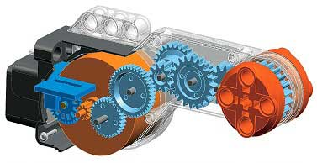
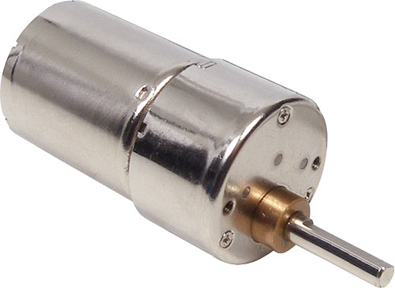
Motors
Two kinds of motors
Plastic Lego motors
Steel 12V Tetrix motors
In competition we use mostly Tetrix motors
Power, torque, physical robustness
But more complicated wiring
We’ll use Lego motors here
Simplicity
Different electrically, similar programatically

Slide 13
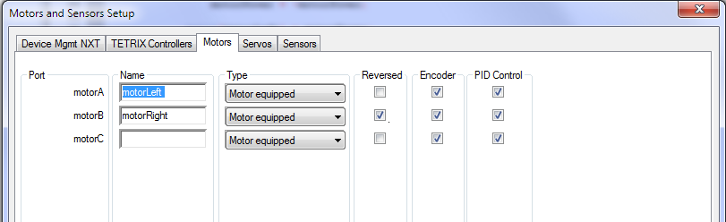
Motors: Configuration
Configure two Lego motors
As if for a “tank-drive” robot
Robot/Motor and Sensors Setup
Will insert #pragma statements at start of your .c file

Slide 14
Motors: Control
Set motor power level using motor[] array
motor[motorLeft] = motorPower;
motor[motorRight] = motorPower;
Motor power ranges from -100 to +100
-100 == full reverse,
100 == full forward,
0 == stop
Power values of magnitude > 100 are clamped automatically

Slide 15
Motors: Encoders
Optical ‘encoders’ attached to motor shafts keep track of how far the shaft turns
Use: you can know how far your robot goes!
Encoders built-in to Lego motors
Optional addition to Tetrix motors
Use whenever you can
Number of encoder ticks per revolution
360 for Lego motors
1440 for Tetrix motors (== 4 * 360)
nMotorEncoder[] array returns encoder values
nMotorEncoder[motorLeft]

Slide 16
Debugging: Tracing to Debug Stream
A place where you can write simple tracing output during program development
Can be really, really handy way to find out what on earth your program is up to
Robot / Debugger Windows/ Debug Stream
Robot / Debugger / (Pause Refresh vs. Continuous)
writeDebugStreamLine(“format string”, values)
writeDebugStreamLine(“my int is: %d”, 3);
writeDebugStreamLine(“my str is: %s”, “hello”);
writeDebugStreamLine(“value of pi is: %f”, PI);
writeDebugStreamLine(“page: %d of %d”, pageNumber, pageCount);
Caution: tracing can be slow-ish
Keep things to just a few traces per second at most

Slide 17
Motors: Exercise
Modify your joystick controller exercise to:
Use the Y value of the left joystick for power
Forward and backward motion of your bot
Use the X value of the right joystick for steering
Left and right motion of your bot
Every half second trace the encoder values to the debug stream
Bonus: report # of motor revolutions instead of raw encoder values
Hints:
Get the forward/backward part fully working before worrying about the left/right part
Then do the tracing part
The nSysTime variable gives you the system time in milliseconds

Slide 18
Motors: Cautions
Some built-in RobotC motor features only work for Lego motors, not Tetrix motors
nSyncedMotors, nSyncedTurnRatio, nMotorRunState, nMaxRegulatedSpeedNXT
nMaxRegulatedSpeed12V has no effect, documentation to the contrary notwithstanding
nMotorEncoderTarget not reliable for 12V
You can accomplish the same effect yourself though
RobotC initializes Tetrix motors when the NXT brick is powered on
Thus, ALWAYS power on your NXT brick after your 12V power supply
Otherwise, motors will coast instead of brake at zero power

Slide 19
Telemetry
Consider the following:
Somehow your bot isn’t behaving like you think it should
Maybe you’re trying to turn the bot using the gyro sensor, and it’s not getting the angle right. Why? Where does the fault lie?
So you want to get some hard data to see what’s going on
Maybe lots and lots of data
And what you really want is some nice charts of this data
RobotC has built in data-logging, but
Limited in capacity to 5k of data
In practice, just not enough
Multiple items per record cumbersome and awkward
Only integer data supported
After program is finished, many-click manual steps needed to import into spreadsheet
Data is staged in files on NXT

Slide 20
Telemetry: TelemetryFTC
Real-time telemetry streaming from NXT directly into Microsoft Excel
Up to about 1000 records per second achievable
Virtually unlimited data capacity
All basic data types supported
int8, int16, int32, uint8, uint16, uint32,
float, string, bool, char
Programatically easy to create multi-item records
Easy to use

Slide 21
Telemetry: TelemetryFTC Basics
Add telemetry calls to your program
Once:
TelemetryInitialize();
TelemetryUseBluetooth(true); // if telemetry will indeed use Bluetooth
As needed:
TelemetryAddInt32(nMotorEncoder[motorLeft]);
TelemetryAddFloat(PI * someFunction());
TelemetryAddString(“hello”);
TelemetrySend();
See TelemetrySample.c for other examples
Run TelemetryFTC
Connect to your NXT using TelmetryFTC UI
Run your program on your NXT
Excel sheet will open automatically and fill up with data
Each telemetry record will be a row in the sheet
Each item in each record will be in its own column
Caveat
RobotC and TelemetryFTC can’t both use Bluetooth simultaneously, so
Connect one with Bluetooth and the other with USB, or
Disconnect RobotC and run program manually using NXT buttons
TelemetryFTC can send joystick to NXT

Slide 22
Telemetry: Excercise
Write a program that sends telemetry records containing the values of the left and right motor encoders
Run each motor at
power==100 for 2 seconds, then power==0 for 1 second
power==90 for 2 seconds, then power==0 for 1 second
power==80 for 2 seconds, …
etc
Include a ms timestamp and a telemetry record serial # as the first two items in each telemetry record
Include appropriate column headers as a first telemetry record
Plot the results in an Excel graph
Hint:
TelemetrySample.c has examples

Slide 23
Advanced++ Topic: Tasks
“Multitasking” is a term used to describe the act of somone doing many things at the same time
In much the same way, computer programs can run multiple tasks concurrently
This technique is like a sharp knife
It can do it’s job very effectively
But it can cut you if you’re not careful
Keeping yourself safe takes constant vigilance and careful thinking
This is rocket science

Slide 24
Tasks: Mechanisms
‘task’ keyword indicates a new task
task displayTask() { … }
Each task will execute concurrently with other tasks
Reality: each task executes for a little while, then the next one gets a turn
Hundreds or thousands of times per second
Non-deterministic
Functions for manipulating tasks
StartTask(displayTask)
StopTask(displayTask)
EndTimeSlice()
Current task has nothing better to do
Let’s other tasks run
Tasks can have priorities
But there be dragons
Using task priorities will only give you grief
Don’t use them! Just don’t!

Slide 25
Tasks: Pitfalls of Concurrency
void deposit(float depositAmount)
{
float balance = readCurrentBalance(); // 1
balance += depositAmount; // 2
writeCurrentBalance(balance); // 3
}
void withdraw(float withdrawalAmount)
{
float balance = readCurrentBalance(); // 4
balance -= withdrawalAmount; // 5
writeCurrentBalance(balance); // 6
}
task oneTask()
{
...
deposit(100.00);
...
}
task anotherTask()
{
...
withdraw(50.00);
...
}
What happens if oneTask() and anotherTask() execute ‘simultaneously’?
Execution order: 1,2,3,4,5,6: ok
Execution order: 4,5,6,1,2,3: ok
Execution order: 1,4,2,3,5,6: disaster

Slide 26
Tasks: Locking
#include “Lock.h”
LOCK accountLock;
void deposit(float depositAmount)
{
LockExclusive(accountLock);
//
float balance = readCurrentBalance(); // 1
balance += depositAmount; // 2
writeCurrentBalance(balance); // 3
//
ReleaseLock(accountLock);
}
void withdraw(float withdrawalAmount)
{
LockExclusive(accountLock);
//
float balance = readCurrentBalance(); // 4
balance -= withdrawalAmount; // 5
writeCurrentBalance(balance); // 6
//
ReleaseLock(accountLock);
}
task oneTask()
{
...
deposit(100.00);
...
}
task anotherTask()
{
...
withdraw(50.00);
...
}
task main()
{
InitializeLock(accountLock);
StartTask(oneTask);
StartTask(anotherTask);
}

Slide 27
Tasks: Three Task Architecture
Main task
Main app logic
“Drive 30cm, Turn left 90deg, Drive until you hit a white line”
Often ‘blocks’, waiting for something to finish or some event to happen
‘Blackboard’ task
High frequency task
Maybe 50 ms interval
Does repetative stuff that needs constant and frequent attention
Only task to actually read sensor values
Computes derived sensor values
E.g.: gyro reports rate of turn, want accumulated turn angle
Stores values in global variables
Computes ‘stop condition’ events for each sensor
E.g.: has the gyro reached a certain angle
E.g.: does the color sensor see a requested color (white)
Main task indicates which sensors and stop conditions are of interest
Does miscellaneous housekeeping
E.g.: Check for motor stall (this will save you $$$!)
E.g.: Check for rotational servo stall
E.g.: Send heartbeat message to hardware that needs it

Slide 28
Tasks: Three Task Architecure (cnt’d)
Display task
Low frequency task
Maybe 750 ms interval
Posts stuff on the NXT display
Important: use locks to control concurrency between tasks
Blackboard lock
Owned by the blackboard task to write the state it updates
Owned by other tasks when they want to read that state
Display lock
Similar

Slide 29
Tasks: Cautions
RobotC quirk
A function may be called only by one task at a time
Exception: all RobotC ‘intrinsics’
So think carefully about who calls which of the functions you write, and what locks (if any) control that
Avoid ‘deadlock’
If using multiple locks, define a strict locking order
E.g.: if you acquire both the blackboard and the display locks, you must get the blackboard lock first
Exception: leaf locks

Slide 30
Tasks: Exercise
Write a program that uses the Three Task Architecture
Choose some sensor(s) for the blackboard task to read if the main task wishes to see them
Define appropriate stop condition events for those sensors and have the blackboard task compute whether those events have been triggered or not
Have the main task perform a sequence of actions based on sensor events
E.g.: Playing beeps or music
E.g.: Starting or stopping motors
Have the display task post some useful diagnostic information to the screen
Bonus: have the blackboard task check for motor stall
A motor is stalled if it has power applied to it but it hasn’t moved in “a while”

